Slide 1
PHISHING EMAIL DETECTION SYSTEM
Rule-Based Email Analysis Using Python

Slide 2
AGenda
Introduction to Phishing
Problem Statement
Project Objectives
Tools & Technologies Used
System Workflow
Project Explanation
Detection Techniques Used
Project Demonstration (Output)
Conclusion
Future Scope

Slide 3
INTRODUCTION
Phishing is a cyber attack performed using fake emails
Attackers trick users into clicking malicious links
Phishing emails look genuine but are harmful
These attacks lead to data theft and financial loss

Slide 4
PROBLEM STATEMENT
Users cannot easily identify phishing emails
Fake links and urgent messages mislead users
Manual detection is unreliable
An automated detection system is required

Slide 5
PROJECT OBJECTIVE
To detect phishing emails automatically
To analyze email content for suspicious keywords
To detect malicious links using Regular Expressions
To classify emails into High, Medium, or Low risk

Slide 6
TOOLS & TECHNOLOGIES USED
Python Programming Language
Regular Expressions (Regex)
Visual Studio Code
File-based Email Analysis

Slide 7
SYSTEM WORKFLOW
User selects the email type
Email content is read from file
Keyword-based analysis is performed
URLs are extracted using Regex
Phishing risk score is calculated
Email is classified based on risk

Slide 8
PROJECT EXPLANATION
The system allows the user to select an email for analysis
The selected email content is read from a file
Email text is converted to lowercase for accurate matching
Suspicious phishing keywords are detected
URLs are extracted using Regex and checked for fake domains
A rule-based risk score is calculated
The email is classified as High, Medium, or Low risk

Slide 9
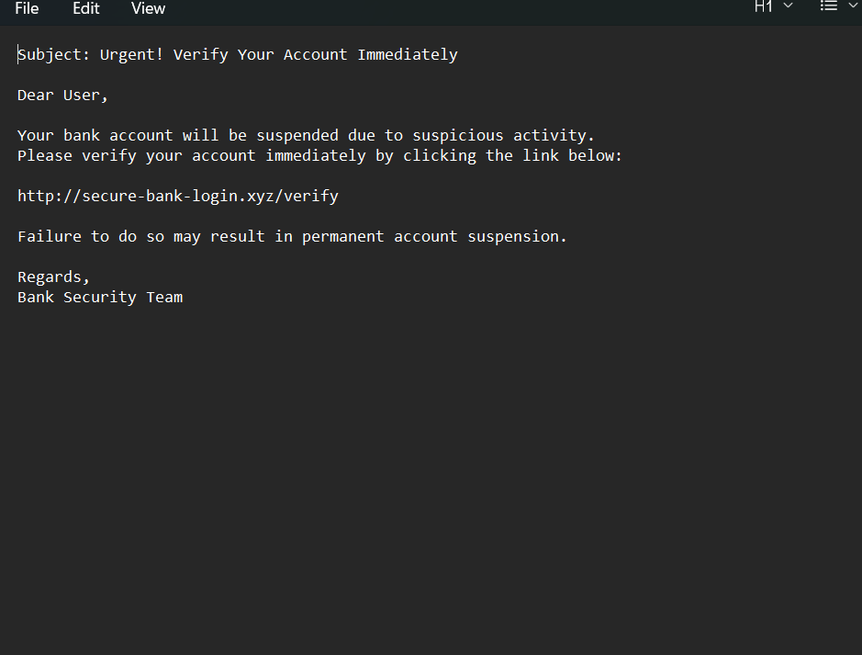
PHISHING EMAIL INPUT
Sample phishing email used for testing
Contains urgent language
Includes a fake malicious link
Simulates a real-world phishing attack

Slide 10
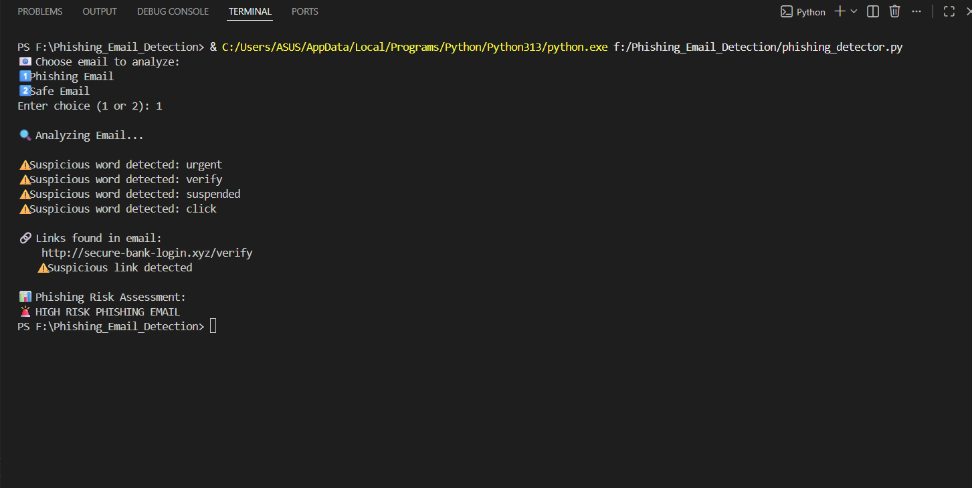
PHISHING EMAIL OUTPUT
Suspicious keywords detected
Malicious URL detected
Risk score calculated
Email classified as HIGH RISK PHISHING EMAIL

Slide 11
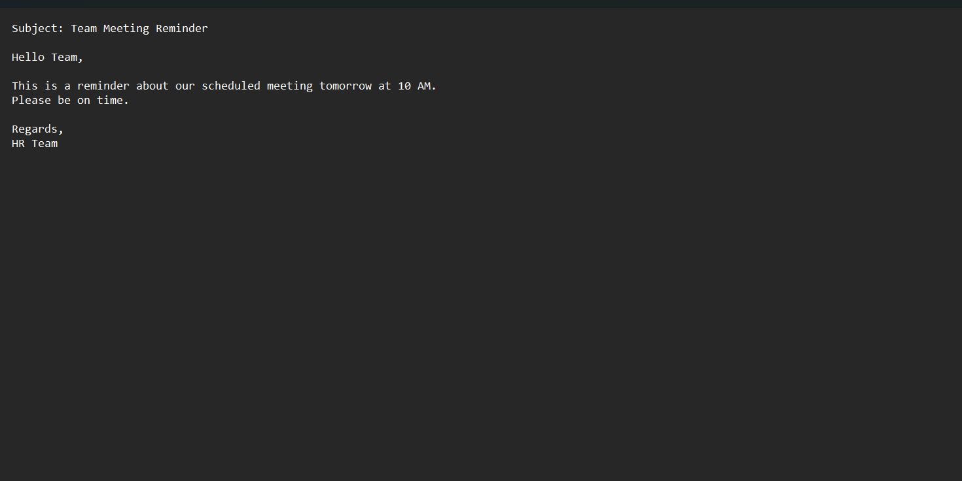
SAFE EMAIL INPUT
Legitimate email used for testing
No urgent language
No malicious links
Represents a normal email

Slide 12
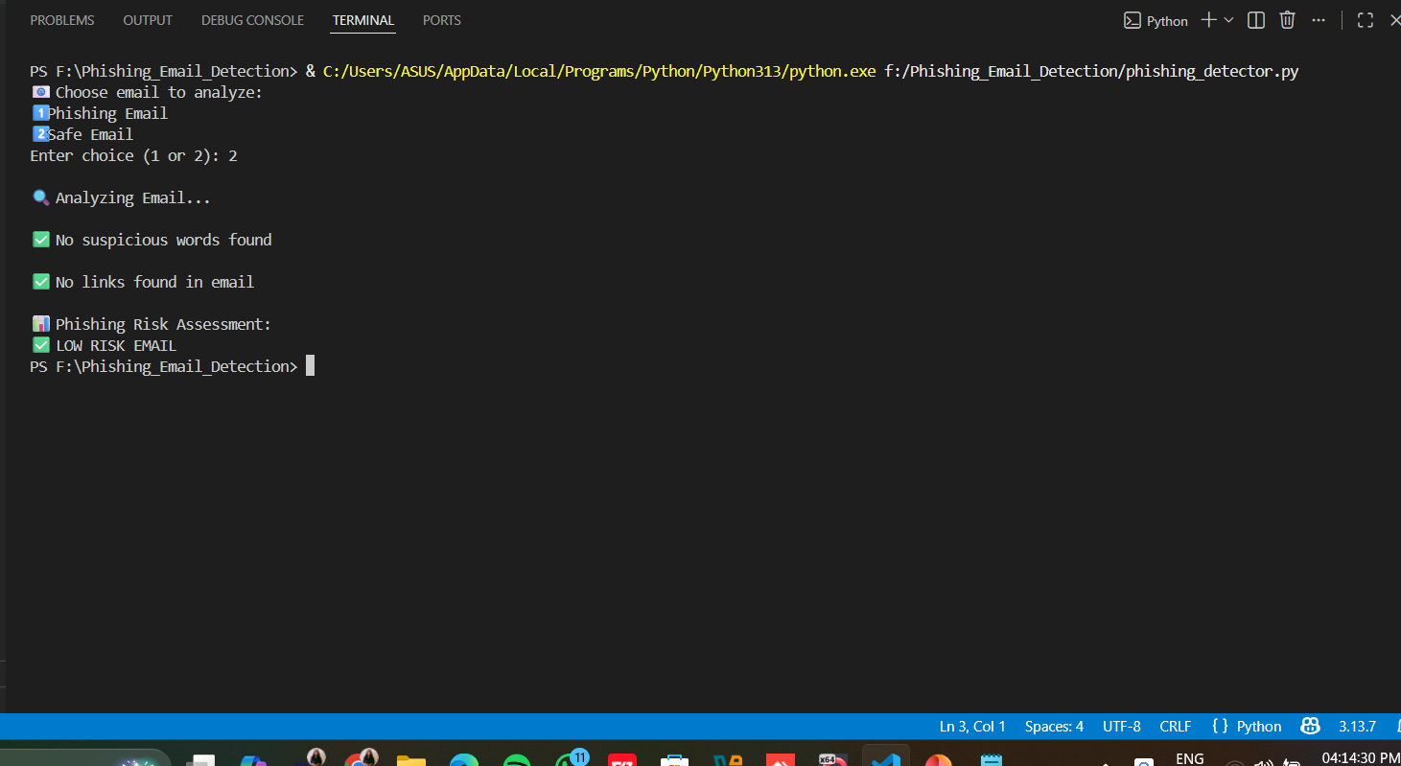
SAFE EMAIL OUTPUT
No suspicious keywords detected
No malicious links found
Low phishing risk score
Email classified as LOW RISK EMAIL

Slide 13
PHISHING RISK SCORING MECHANISM
Each suspicious keyword increases risk score
Each detected link increases risk score
Higher score indicates higher phishing probability
Rule-based classification is applied
Risk Levels:
High Risk
Medium Risk
Low Risk

Slide 14
CONCLUSION
Successfully detects phishing emails
Keyword and link-based analysis improves accuracy
False positives are minimized
Demonstrates Blue Team defensive security concepts

Slide 15
FUTURE SCOPE
Email header analysis
Domain reputation checking
Machine learning-based phishing detection
Real-time email scanning

Slide 16
Thank YOU !!

